Slide 1
License plate Recognition Week 3 Report
JUDO
2020. 10. 12
한선도, 김주호

Slide 2
JUDO
1. Image Detection Colab_code

Slide 3
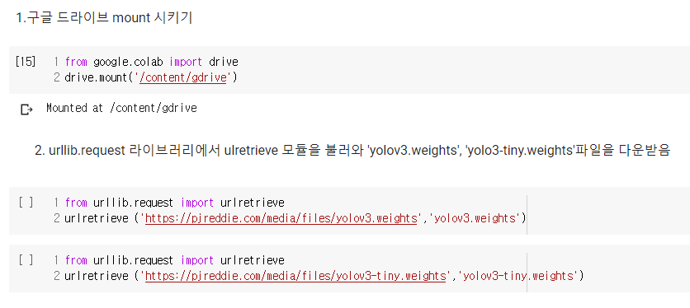
Image detection Colab_code
JUDO
1. 작업환경 구성(Mount, Download)

Slide 4
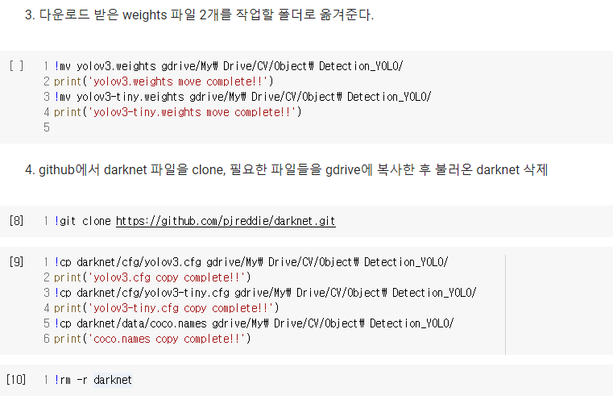
Image detection Colab_code
JUDO
1. 작업환경 구성(file 옮기기, Clone)

Slide 5
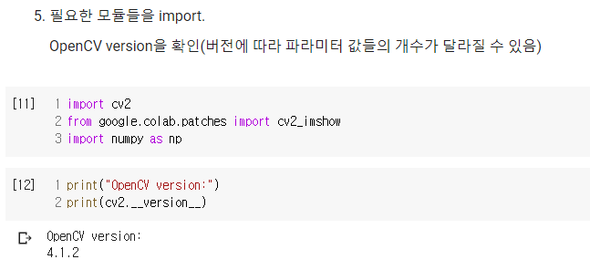
Image detection Colab_code
JUDO
1. 작업환경 구성(Module import, OpenCV version 확인)

Slide 6
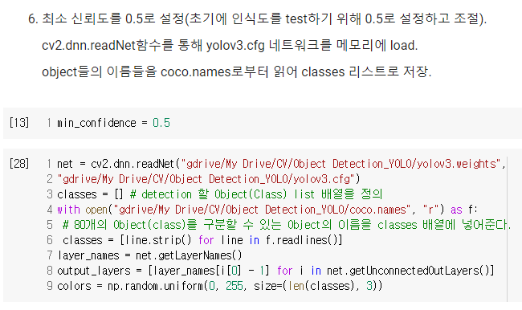
Image detection Colab_code
JUDO
2. 필요한 file load & parameter 설정

Slide 7
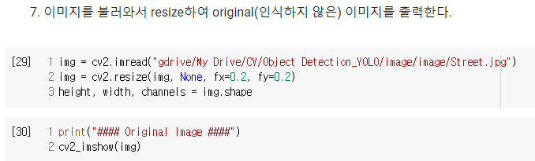
Image detection Colab_code
JUDO
2. Image File Load

Slide 8
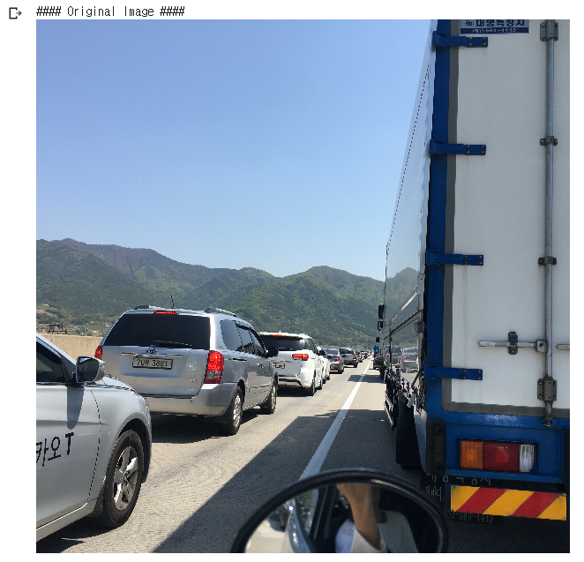
Image detection Colab_code
JUDO

Slide 9
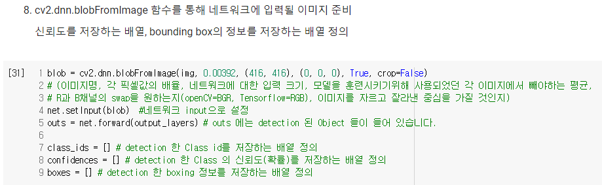
Image detection Colab_code
JUDO
3. Image file에 대한 data 작업(Parameter 배열 생성)

Slide 10
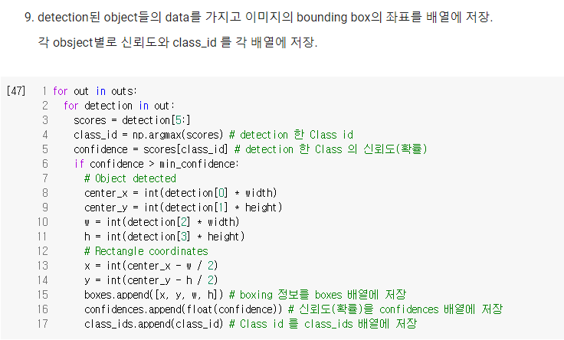
Image detection Colab_code
JUDO
3. Image file에 대한 data 작업

Slide 11
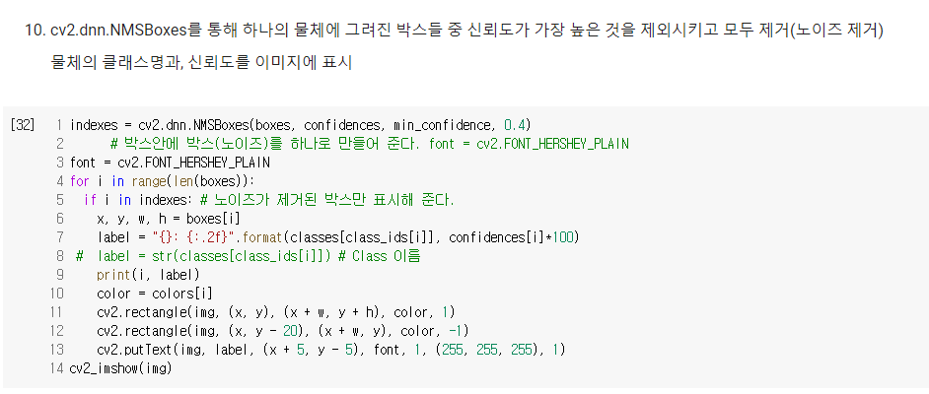
Image detection Colab_code
JUDO
4. Image 결과 출력 (Bounding Box, Confidence)

Slide 12
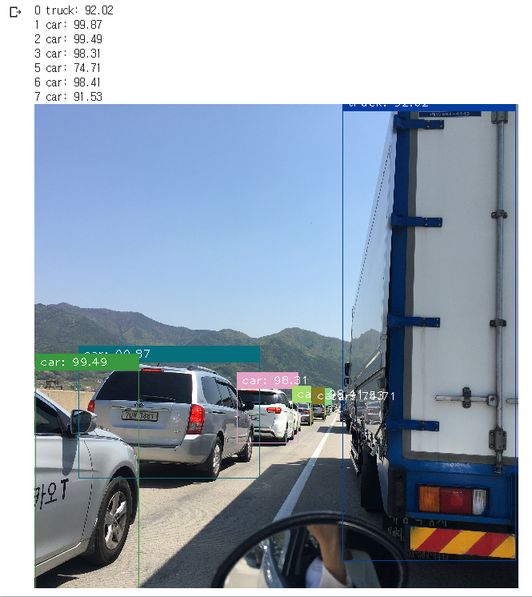
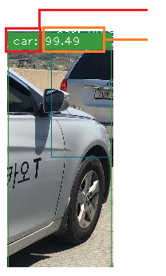
Image detection Colab_code
JUDO
<Result Image>
Class name 표시
Confidence 표시
‘Car’를
99.49(%)
신뢰도로 인식

Slide 13
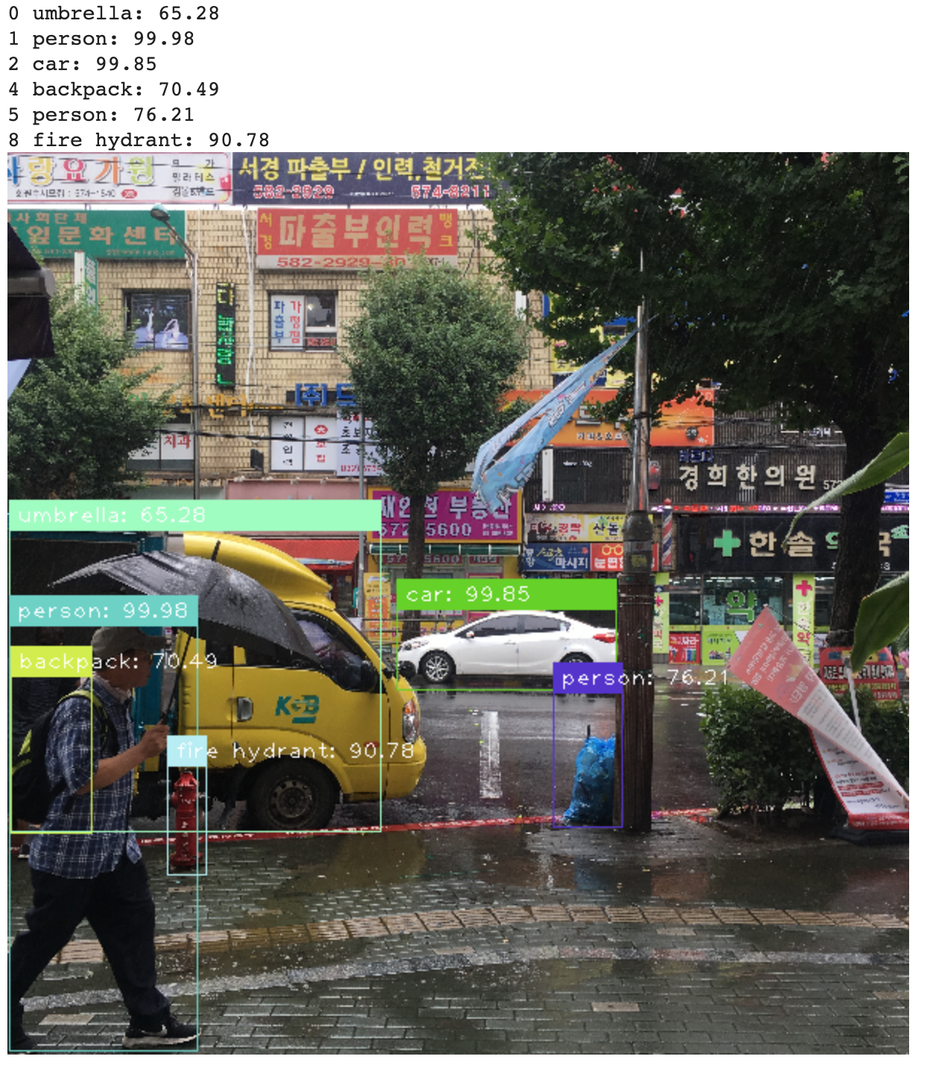
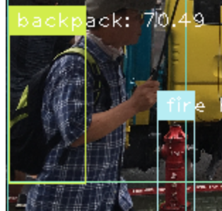
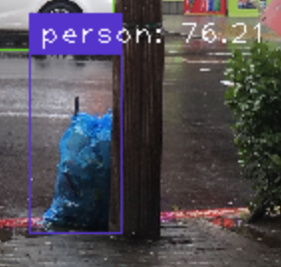
Image detection Colab_code
JUDO
<Result Image>
Backpack
-> 70.49 %
쓰레기를
사람으로 인식
-> 76.21 %

Slide 14
JUDO
2. Plate Recognition Colab_code

Slide 15
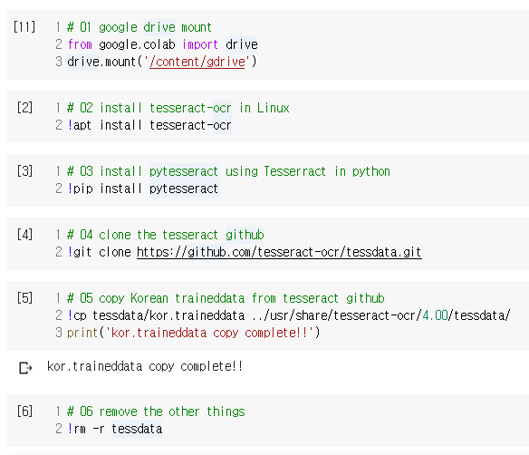
Plate Recognition Colab_code
JUDO
1. 작업환경 구성 (Mount, Install files, 한국어 tesseract)

Slide 16
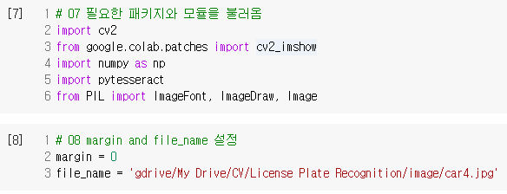
Plate Recognition Colab_code
JUDO
1. 작업환경 구성 (Module import, image load)

Slide 17
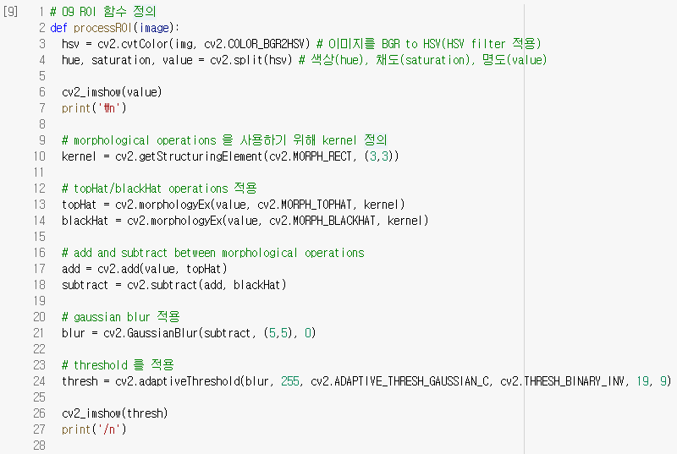
Plate Recognition Colab_code
JUDO
2. ROI Function (함수 정의, Parameters setting)

Slide 18
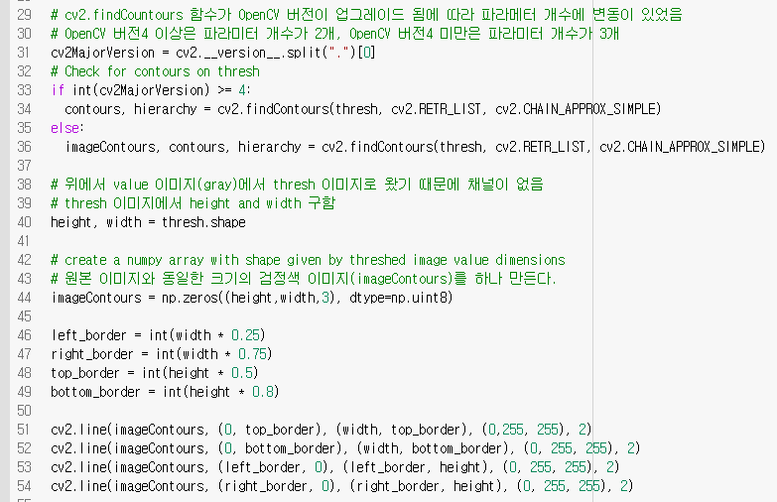
Plate Recognition Colab_code
JUDO
2. ROI Function (OpenCV version 출력구별, ImageContours 생성)

Slide 19
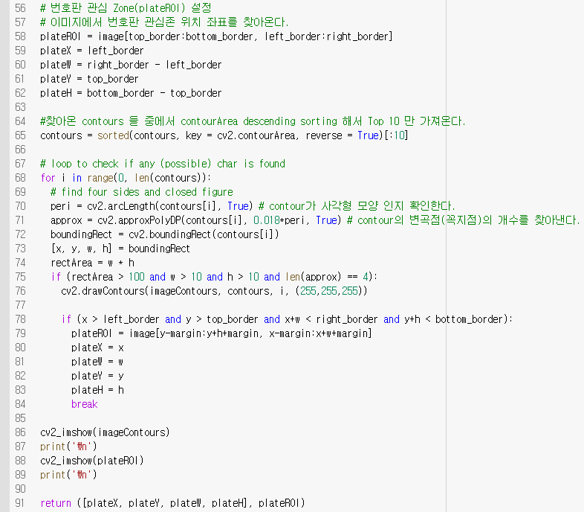
Plate Recognition Colab_code
JUDO
2. ROI Function (Contours data, Bouning box 좌표 추출)

Slide 20
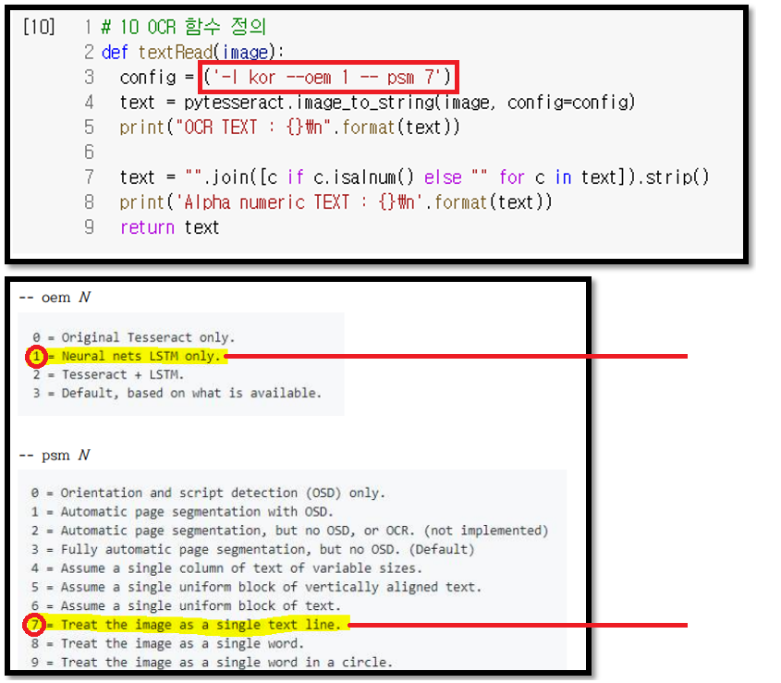
Plate Recognition Colab_code
JUDO
3. OCR Function (tesserract)
<Tesseract 옵션 설정>
OCR engine mode 설정
이미지에 대한
Layout 분석 방법을 결정
Reference: https://github.com/tesseract-ocr/tesseract/blob/master/doc/tesseract.1.asc

Slide 21
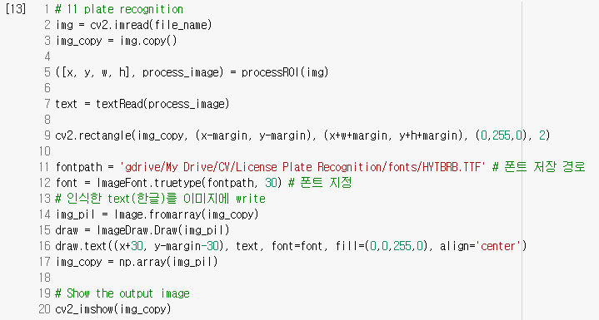
Plate Recognition Colab_code
JUDO
4. Plate Recognition (image에 차량번호 출력)

Slide 22
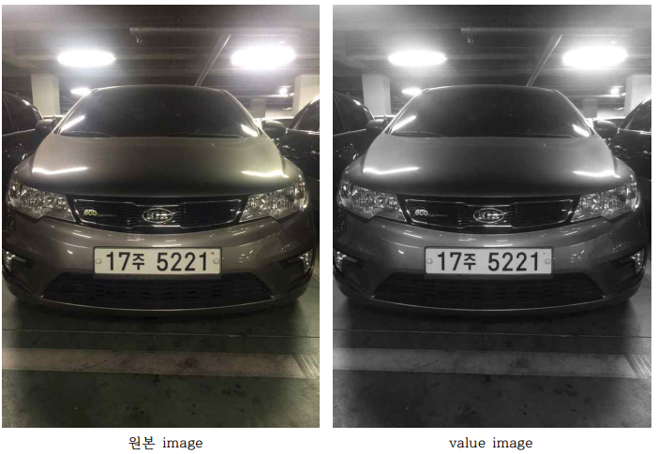
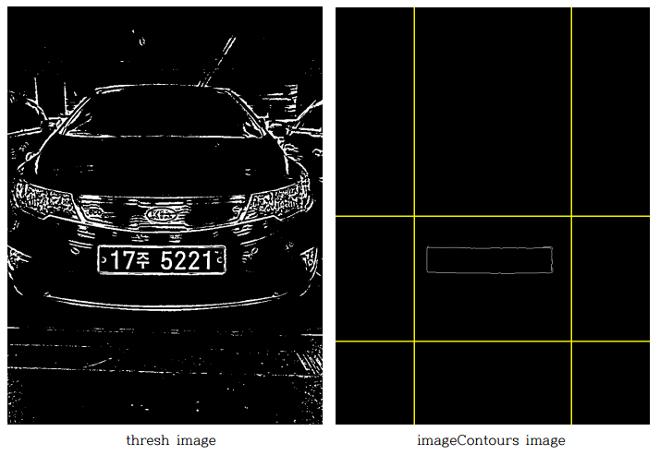
Plate Recognition Colab_code
JUDO
<Result Image>
Original image
Value image
Thresh image
ImageContourt image

Slide 23
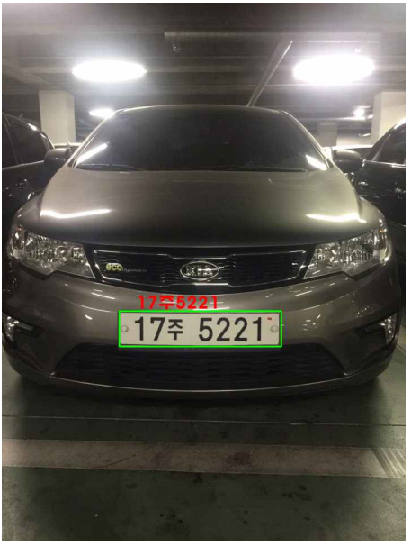
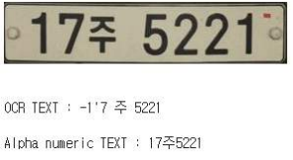
Plate Recognition Colab_code
JUDO
<Result Image>

Slide 24
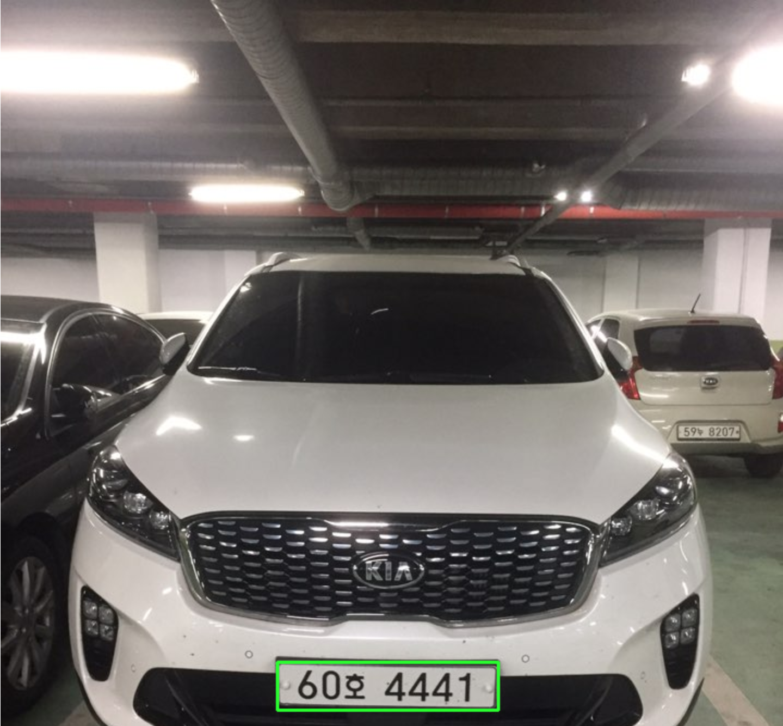
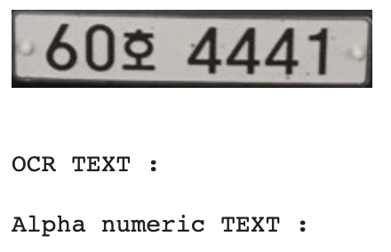
Plate Recognition Colab_code
JUDO
<Result Image>
-> 다른 차량의 사진에서는 번호판을
인식하지 못함

